Slide 1
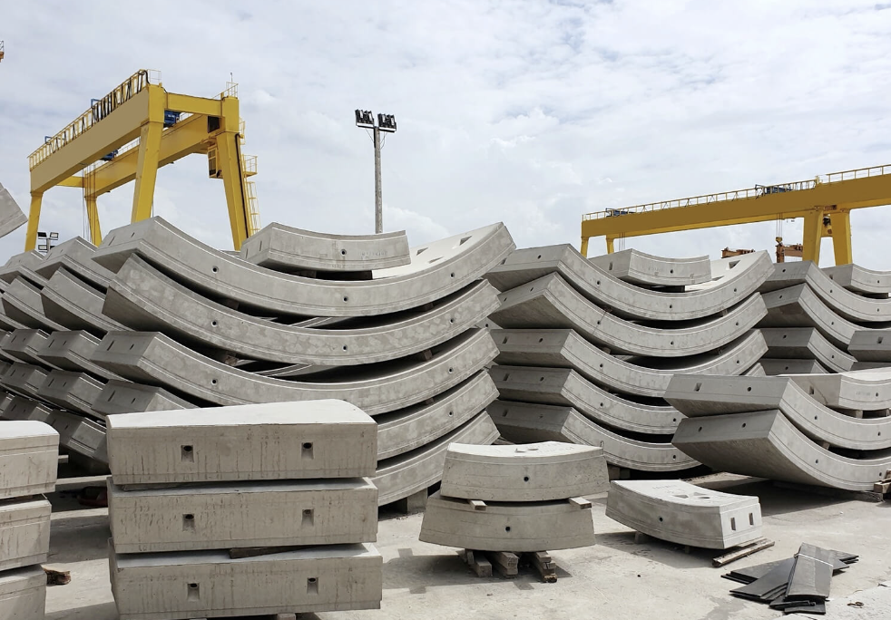
MIVES-VS Visualisation tool
Tecla Bottinelli M.
Alexandre Clément
Iman Masrun
Mengjie Zou
SHS
How people learn
18.04.2023
Notes:
MIVES method [1], a multi-criteria analysis framework to assess the sustainability of a given decision or project through a mathematical approach. Our project
aims at introducing the MIVES method to civil engineering students in the context of the course in Advanced design of concrete structures at EPFL by providing them with an interactive tool that will help them evaluate the sustainability of the buildings they design now and in their future careers.

Slide 2

Running VS-MIVES
If you have Windows, you can download the executable version of the file (mives.exe) and double click it to run it (wait a bit). You might need to confirm « run anyways ». But the preferred option for the moment is to run it as follows:
If you have a Mac, you need to download the complete folder and open it with your prefered platform with Python (we reccommend using Visual Studio Code).
Before running the file, in the terminal window write «sudo pip install -r requirements.txt» to make sure all the needed packages are installed. If this doesn’t work for you you can install them one by one with «sudo pip install package». The needed packages are (PyQt5, ete3, six, numpy, matplotlib, and pandas).
Then run mives.py. The main window should appear!
An interactive tool to introduce the MIVES method, a multi-criteria analysis framework to assess sustainability.
Notes:
Script:
Our team is working on enhancing an existing visualization tool to provide a comprehensive and user-friendly solution for assessing sustainability when working on your project.
The tool is designed to be efficient and engaging, which makes it a good solution for students who want to learn about the principles of sustainability and how to apply them to their projects.
Through this tool, we aim to help students achieve a deeper understanding of sustainability, and we believe it has the potential to promote sustainable practices in various fields.
In this presentation, we will demonstrate our prototype, to explore the key features and functionalities of the tool.

Slide 3
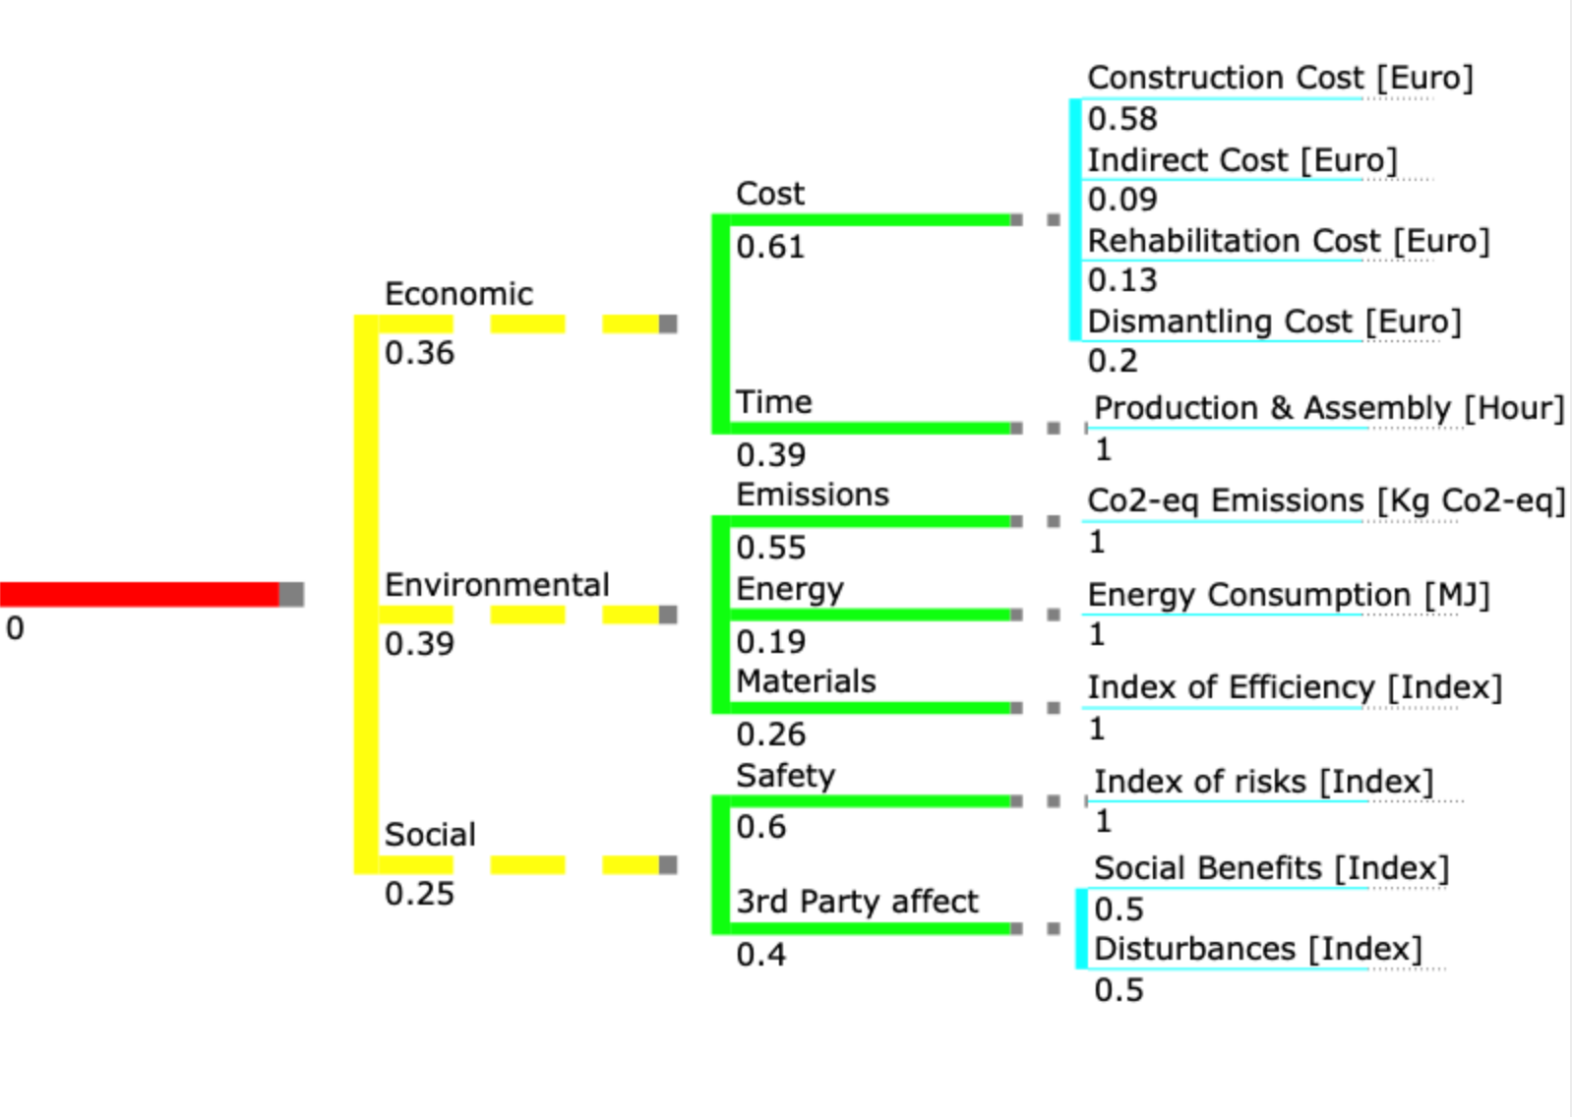
Main tree
The MIVES method is a set of techniques used for assessing the sustainability of design solutions. The method can be divided into several steps :
Definition of the problem and decisions to be made.
Realization of a tree diagram.
Definition of the value functions, i.e. index which expresses the degree of satisfaction.
Definition of the weights.
Definition of design alternatives.
Evaluation of the global index achieved by each design solution.
Make the right decision based on the results obtained
Input each weight
pillars
criterion
indicators

Slide 4
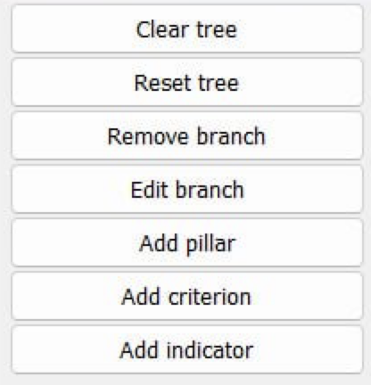
Main menu
Removes everything
Resets from last version
Removes one of the branches
Edits weight of one of the branches
Adds one pillar at the beginning along with «economic», «social», and «environmental».
Adds one more criterion. First, you choose the pillar to add to. Then you choose weight.
Add branch in third generation, decide the weight and then it asks to choose the value function

Slide 5
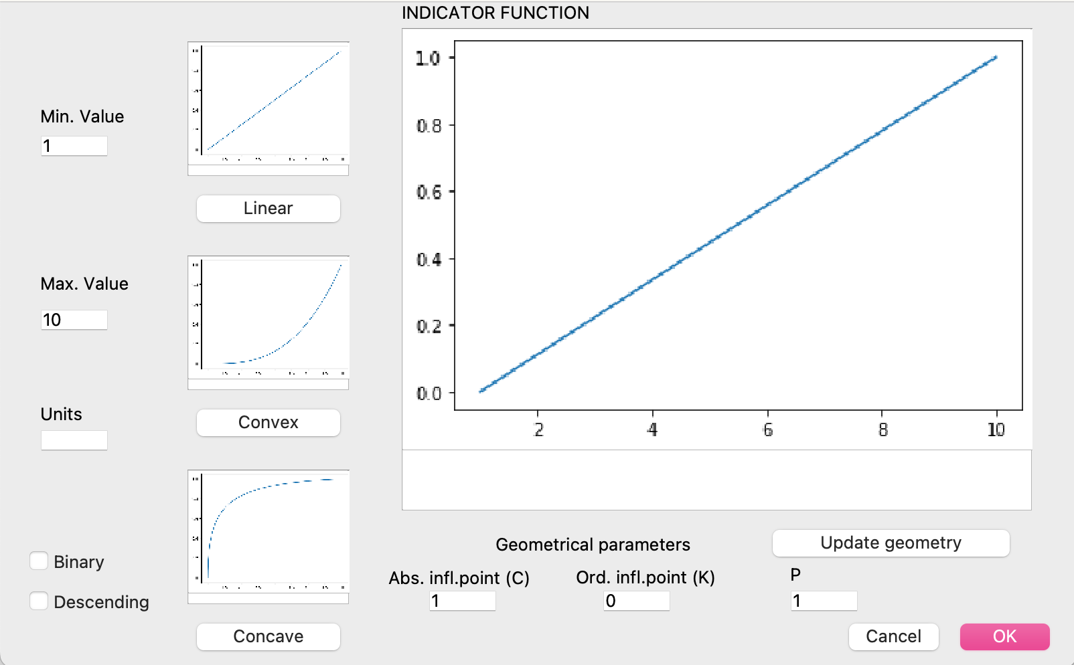
Indicator value function
Max/min values of x axis (indicator value)
Satisfaction value for each indicator
Defining each value function requires measuring preference or the degree of satisfaction produced by a certain alternative.
The shape of the functions determines how strict or lenient we need to be in meeting the requirements to fulfill a certain standard.
To modify the curvature of the convex and concave plots. P is polynomial order, the others are inflexion points of x and y axis.
Yes or no
Decreasing function

Slide 6
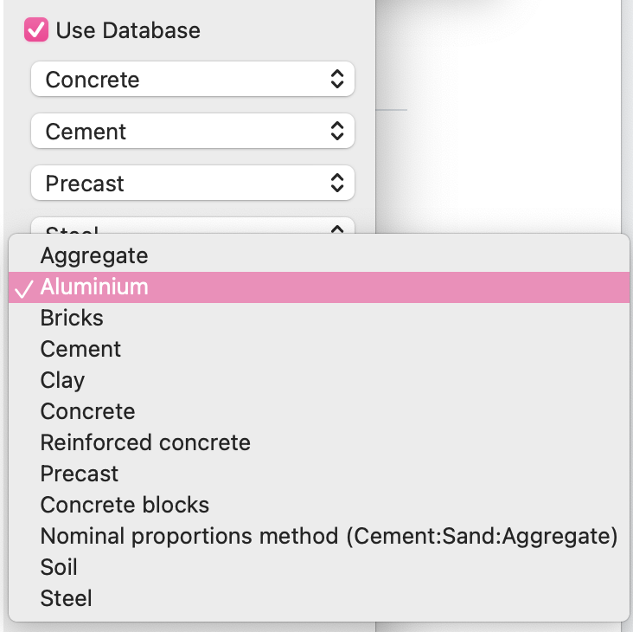
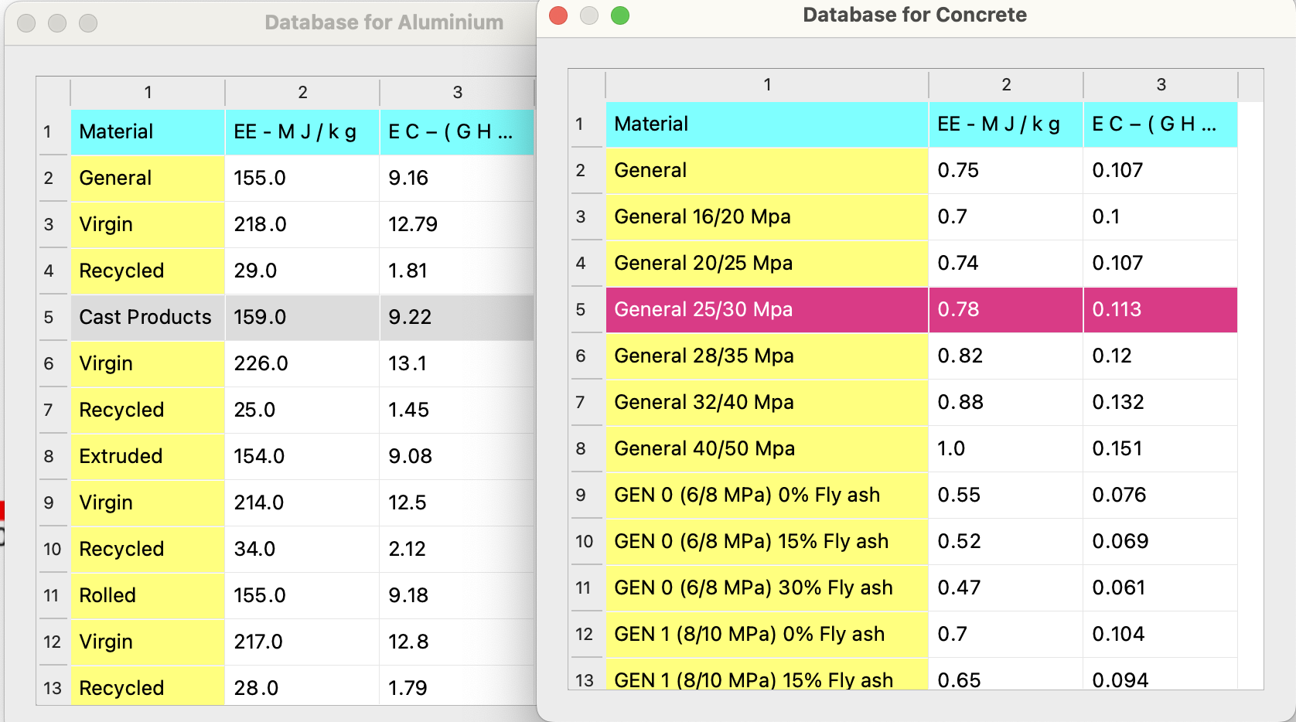
Database
You can find a short version of the ICE database based on ICE V2.0 (Hammond & Jones, 2011) in the main window.
There are 12 material categories with many subcategories. Choose up to 5 materials and note down the values of Energy [Mj/kg] and GHG [Co2 eq/]. You need to know the amount of material that will be used or each category and then multiply it.
Add everything together and input this value in the next window

Slide 7
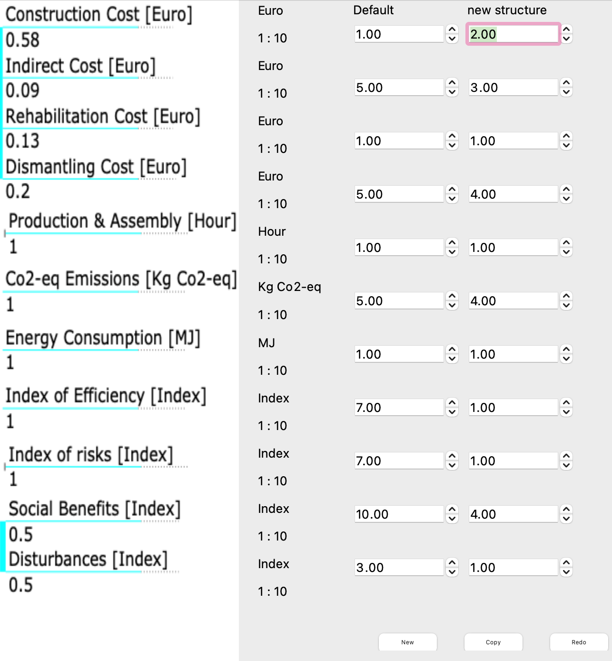
Input of the database parameters
Input values (from min. to max.)
Here you need to multiply your total mass by the value found in the database for each material. These are your inputs.
Different options can be implemented and compared

Slide 8
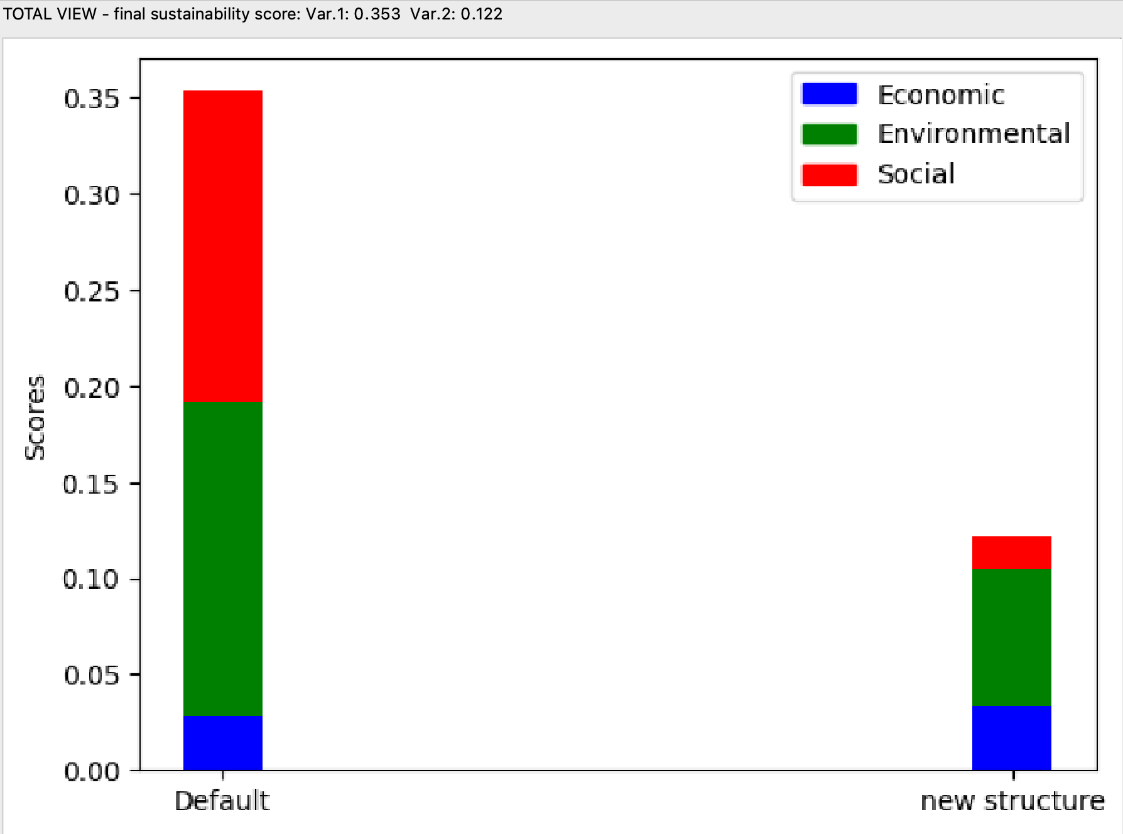
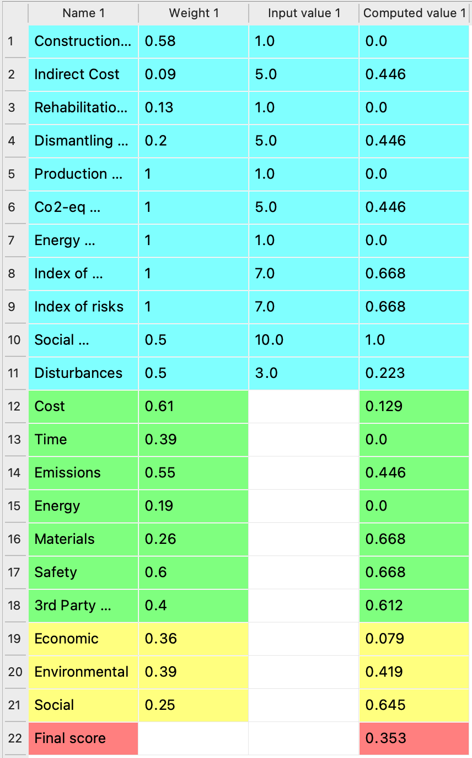
Final results and analysis
Table of total scores. Inputs and outputs
indicators
criterion
pillars
Results per pillar or total view

Slide 9
Have fun :)
Contact us if you need any technical support:
tecla.bottinellimontandon@epfl.ch
alexandre.clement@epfl.ch
iman.masrun@epfl.ch
mengjie.zou@epfl.ch

